Slide 1
Best Practices introducing Kubernetes
Wojciech Barczyński [Head of Engineering]
SMACC.io | Hypatos.ai
Notes:
Aka People says K8S runs on your fridge till 2020

Slide 2
Whoami?
Success
Developer
System Engineer
I am fixing things
Technical Debt
Notes:
Makefile has all what we need for the development process

Slide 3
Experience
Lykehq – [12.2016 - 07.2017]
SMACC.io – [10.2017 - present]
Hypatos.ai – [08.2018 - present]
Before:
Cloud&Heat (Openstack, green data centers) and SAP R&D.
Notes:
Makefile has all what we need for the development process

Slide 4
Experience
Success
Continuous Deployment
X to Kuberentes
Microservices
...
Technical Debt
Notes:
Makefile has all what we need for the development process

Slide 6
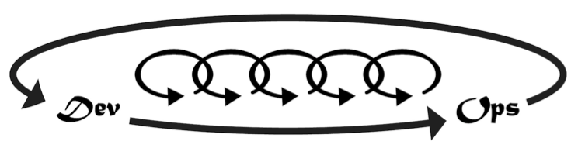
Three ways:
Flow
Feedback
Continuous Experimentation and Learning

Slide 7

Proces of small fixes.
Every sprint better then one before.

Slide 8
1 week sprints
Max 2 weeks*
Notes:
* - it changes, e.g., 1-week might work in Feb, 2-week later

Slide 9
Changes
Productivity
Morale of each team members

Slide 10
Automate!

Slide 11

Finding golden mean

Slide 12
Risks of Automation
Never-ending optimization
Easy to frustrated
Go in wrong direction
As we go, it gets harder
https://en.wikipedia.org/wiki/Cargo_cult

Slide 13
Risks of Automation
Never-ending optimization
Easy to frustrated
Go in wrong direction
As we go, it gets harder
Time-boxing! V1/V2
https://en.wikipedia.org/wiki/Cargo_cult

Slide 14
Analogy: Quality of software
Never-ending optimization
Easy to frustrated
Go in wrong direction
As we go, it gets harder
Rigid code

Slide 15
Analogy: Quality of software
Never-ending optimization
Easy to frustrated
Go in wrong direction
As we go, it gets harder
Rigid code
Ship it!
Make mistakes
Patching
Patching…

Slide 16
Low Quality Low Automation

Slide 17
N-sprint: We are working on Kubernetes… … …

Slide 18

New tech Early wins Trust

Slide 19
Semi-manual first*
Semi-manual first*
Automate!
Automate!
Our perfect way to run our platform

Slide 20
Changes of requirements
Our perfect way to run our platform

Slide 21
New team member

Slide 22
team inclusion diversity engineering culture
How to find it?
Notes:
Strong opinions weekly hold

Slide 23
Assumptions
Basics covered: Continuous Deployment
Without Continuous Delivery, hard to get started

Slide 24
Semi-manual first
Literate Pull Request
README
Makefile
Notes:
https://en.wikipedia.org/wiki/Literate_programming

Slide 25
Literate Pull Request
Comments / Description
shall, salt, ansible, terraform, curl
Screenshoty
Notes:
https://en.wikipedia.org/wiki/Literate_programming

Slide 26
README
Receipt: mix text and commends, avoid screenshots if we can:
Description
Run terraform
Call curl, …
Create user
Notes:
https://en.wikipedia.org/wiki/Literate_programming

Slide 27
README
Few sprints, we can live with commends C&P from README.
We treat it as a code.
+ Architecture Decision Records
Notes:
https://en.wikipedia.org/wiki/Literate_programming

Slide 28
From semi- to automatic
Better understanding of requirements
New team member, new project, some kind of impulse
Notes:
Timing matters: https://gist.github.com/adamwiggins/5687294

Slide 29





Options

Slide 30
Declarative
tf files easy to understand
You know what it will do: Dry run (plan)
One to rule them all
+ Terragrunt

Slide 31
Kubernetes
Hidding
Infrastructure
Simple* Continuous Deployment
https://en.wikipedia.org/wiki/File:Dr_Who_(316350537).jpg

Slide 32
Common Language Artifacts Platform
Notes:
The language of Kubernetes let us to use minimum working set, we do need to jump to 100s line Kubernetes configuration files. Verbs

Slide 33
Learn-as-you-go
https://www.flickr.com/photos/bruno_brujah/

Slide 34
apiVersion: apps/v1 kind: Deployment metadata: name: my-app spec: replicas: 1 template: metadata: labels: name:my app: ruletheworld spec: containers: - name: yourapp image: yourapp:1.0.0 ports: - containerPort: 80
https://www.flickr.com/photos/bruno_brujah/

Slide 35

Experiment and Learn
1. Deploy Cloud-Native app
2. Make a Hell of Mistakes
3. Get it right or Postpone
Notes:
We have a powerful tool.

Slide 36
Experiment and Learn
1. Deploy Cloud-Native app
2. Make a Hell of Mistakes
3. Get it right or Postpone
Deploy
and patch!
Notes:
We have a powerful tool.

Slide 37
No free lunch – application way smarter (12factorapps, metrics, coordination…)
https://www.flickr.com/photos/160866001@N07/

Slide 38
Application
Work with devs side by side
Help to create Dockerfile or optimize it
Adding metrics, structured logs
Preparing copy&paste templates
Notes:
Makefile has all what we need for the development process

Slide 39
Application
Get more sophisticated
More operation responsibility, e.g., data migrations
See: 12factorapps
Notes:
Makefile has all what we need for the development process

Slide 40
Keep it simple
https://www.flickr.com/photos/bruno_brujah/

Slide 41
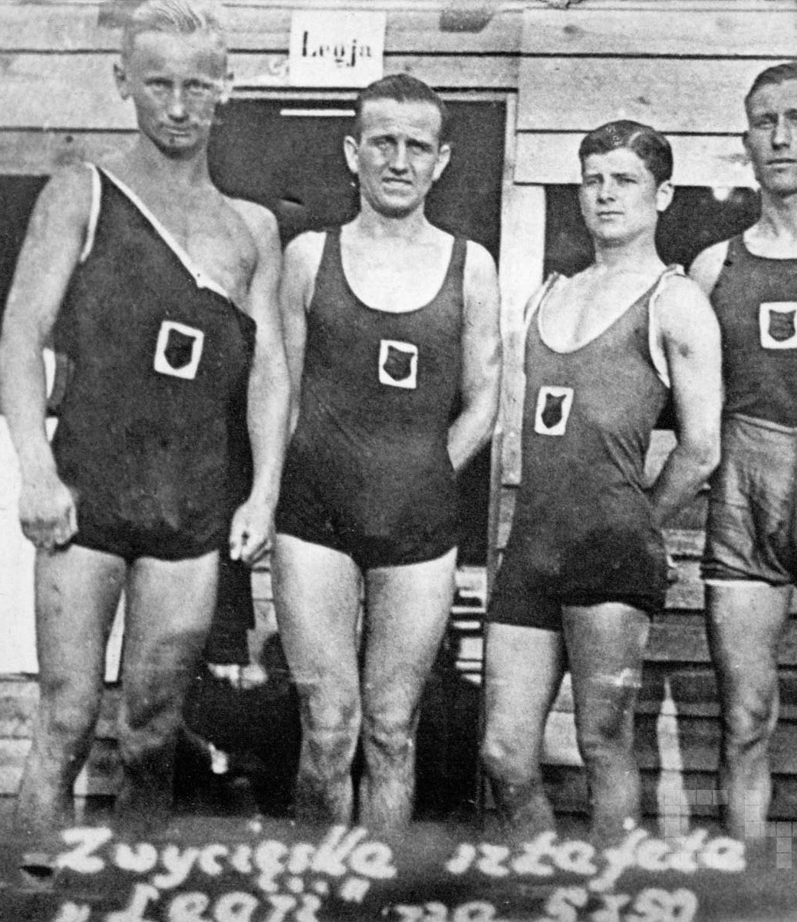
Keep everybody in the process
Teach the team Kubernetes definitions
Keep the process understandable and simple

Slide 42
Keep everybody in the process
Do not terrorize with how-amazing-Kubernetes-is :D
Hide complexity

Slide 43
Keep everybody in the process
Amplify the feedback

Slide 44
Conventions over tools!
Common conventions for repos
No a single deploying tool
No encrypted data in repo
ps. Only when you are really really ready.

Slide 45
Keep everybody in the process
Copy & Paste:
Makefile
Kubernetes files
TravisCI
curl https://github.com/smacc-ci/deploy.sh | bash
Notes:
Makefile has all what we need for the development process

Slide 46

Friendly CD
make run_local
Code on master → develop env
Development
Notes:
Kelsey Hightower

Slide 47
Friendly CD
3. Git tag → staging env
4. PR accepted on hy-platform.git → production env
Staging
Production

Slide 48
How we got there?
https://www.flickr.com/photos/bruno_brujah/

Slide 49
Every component deployed independently to k8s
No platform.git
C&P Makefile, TravisCI

Slide 50
Kubernetes training
System Engineer (me) next to devs
Makefile with a lot of k8s commands

Slide 51
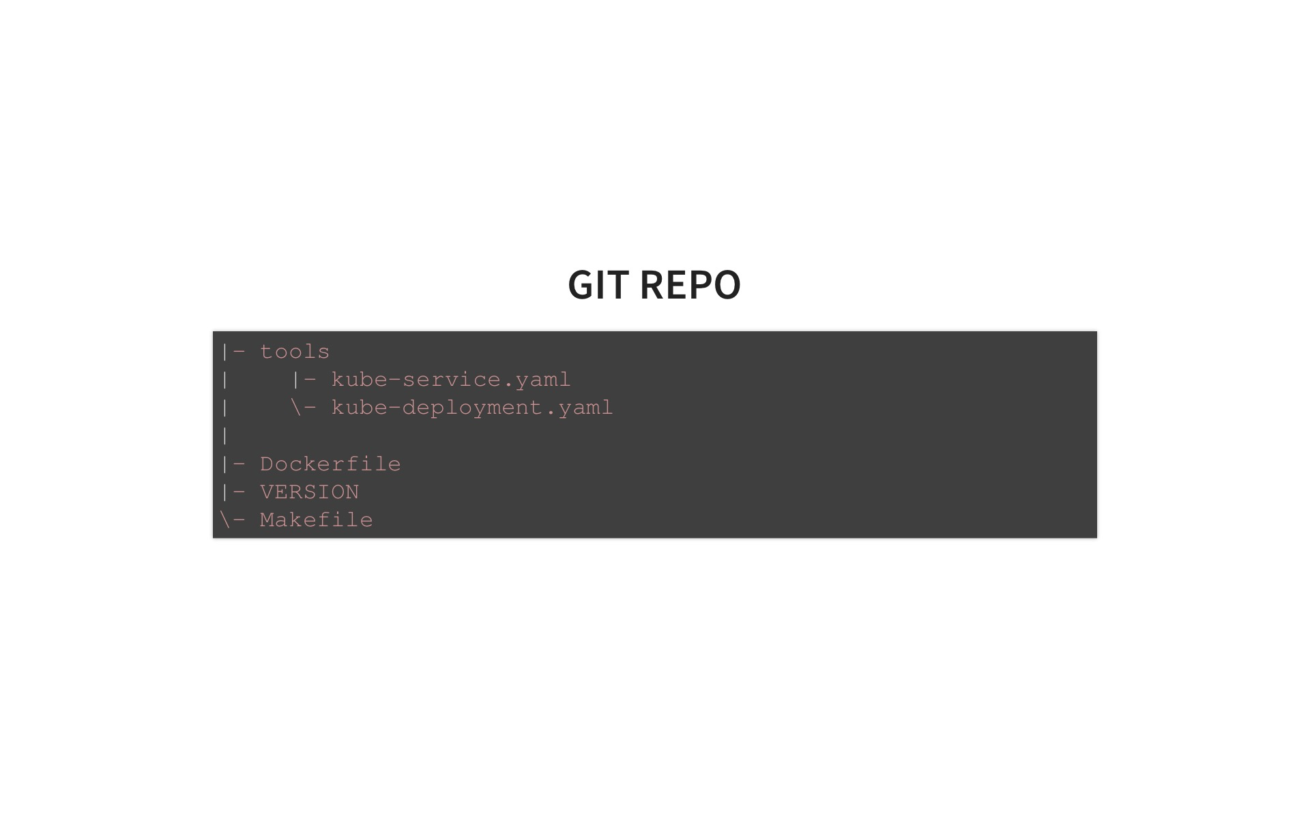

Slide 52
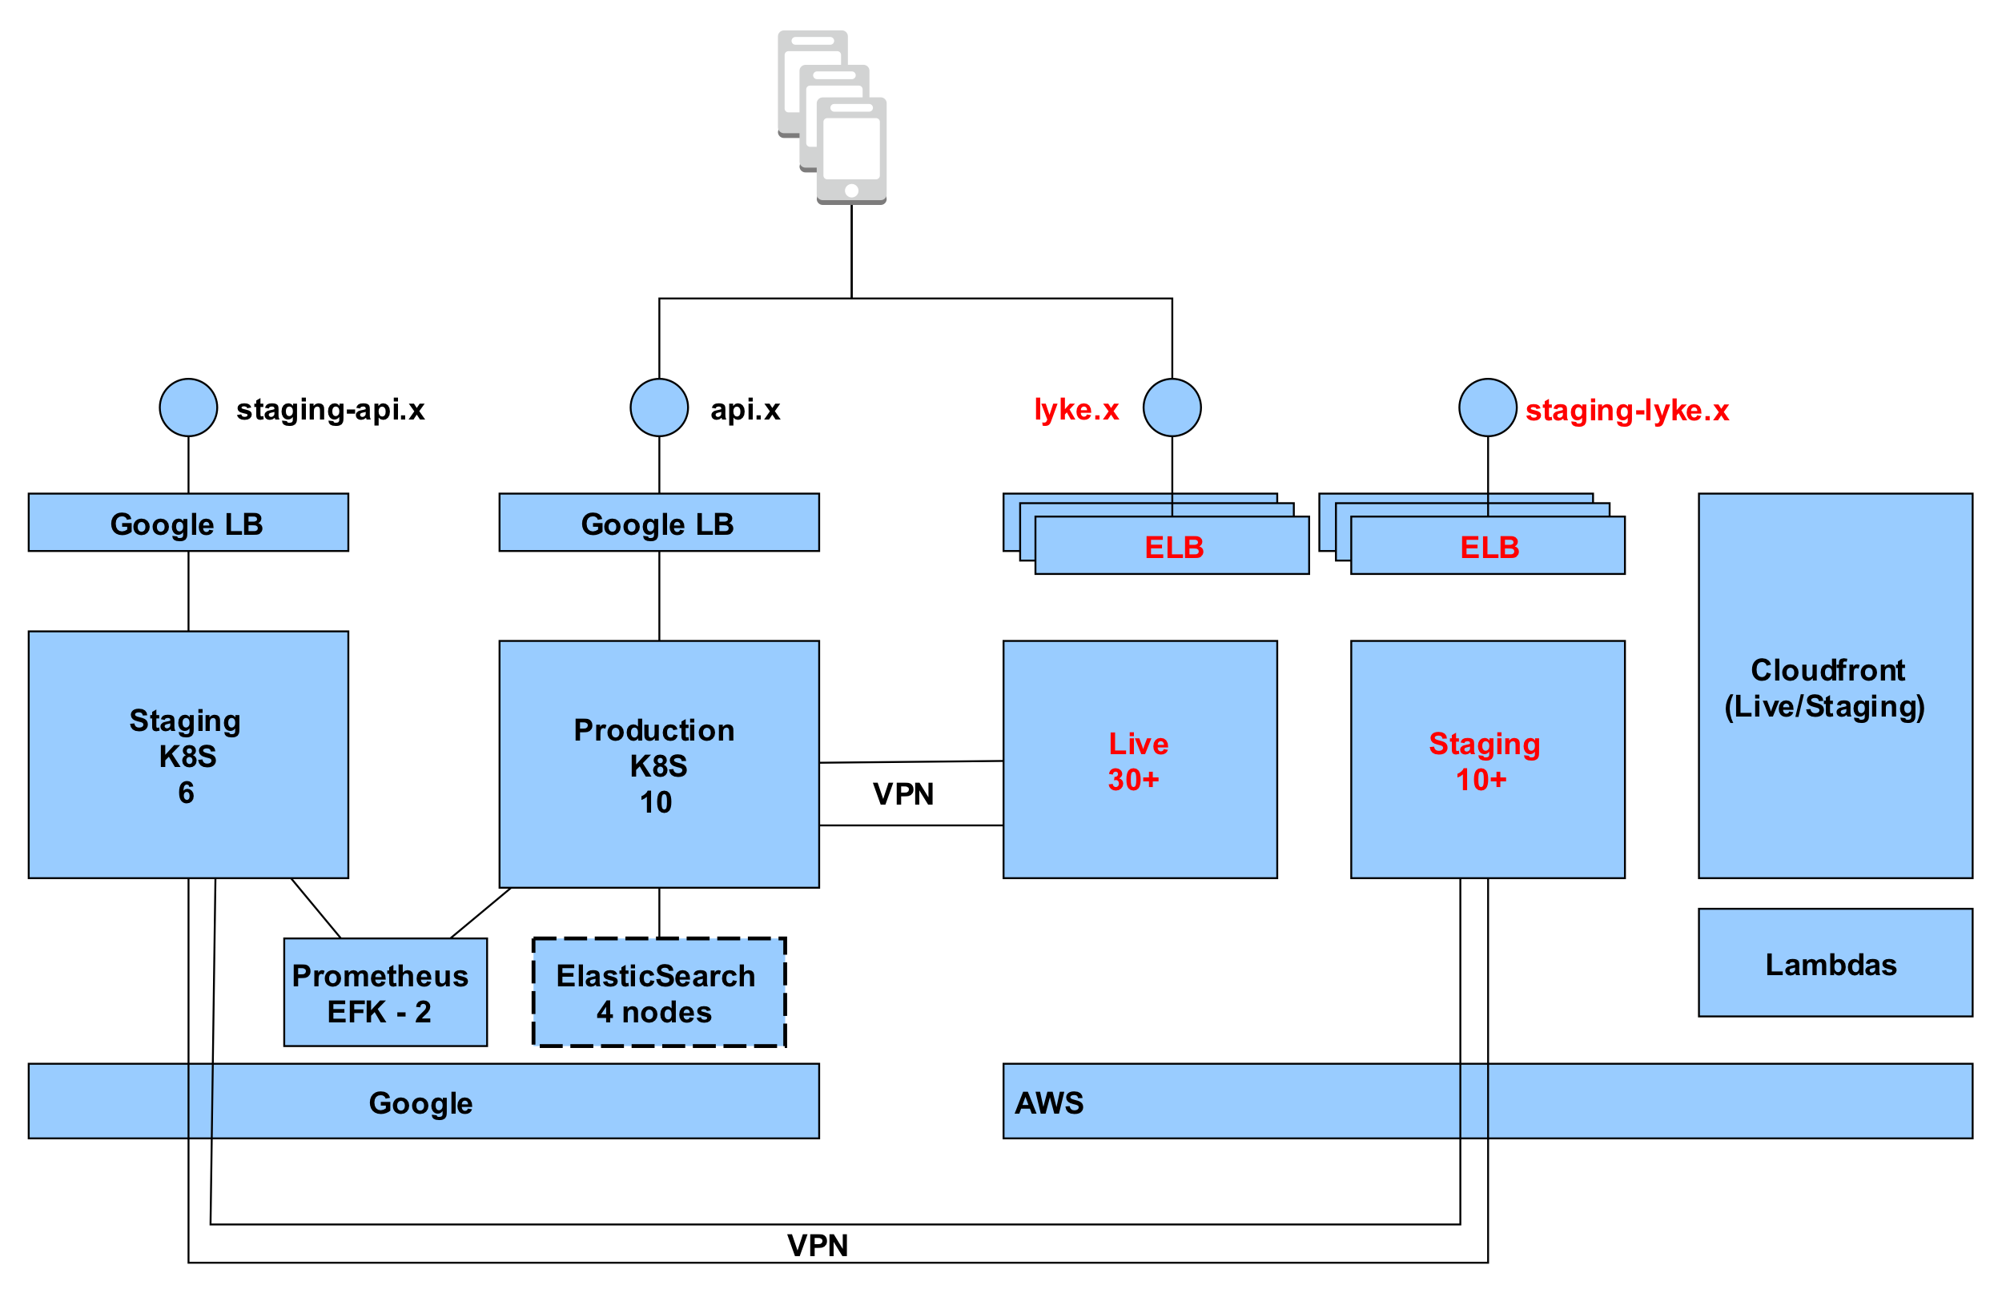

Slide 53
Two teams in Warsaw and Berlin
Machine Learning components

Slide 54
Two teams in Warsaw and Berlin
Machine Learning components
Keep it simple!

Slide 55
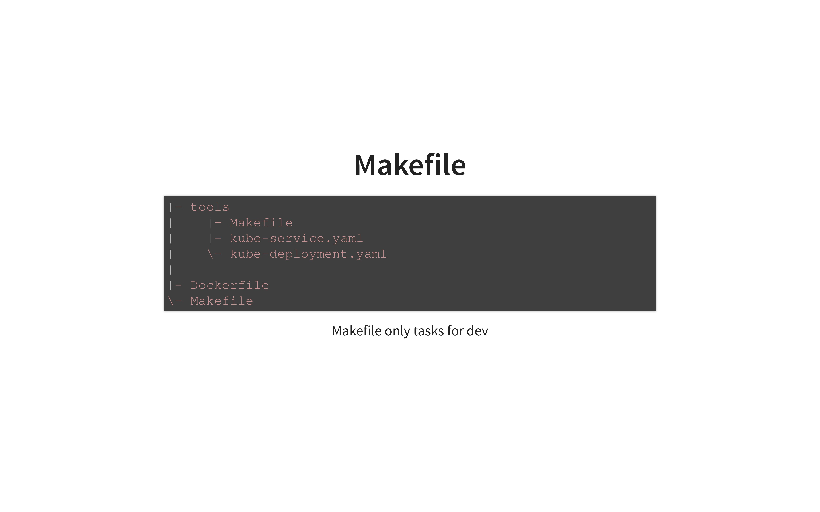

Slide 56
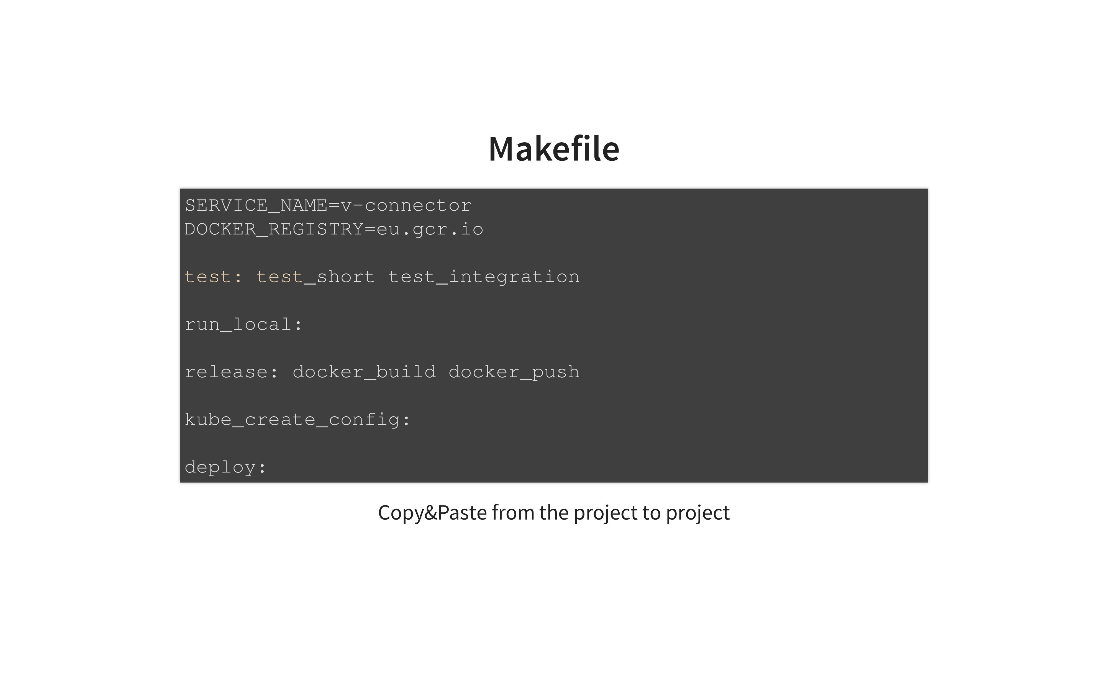

Slide 57
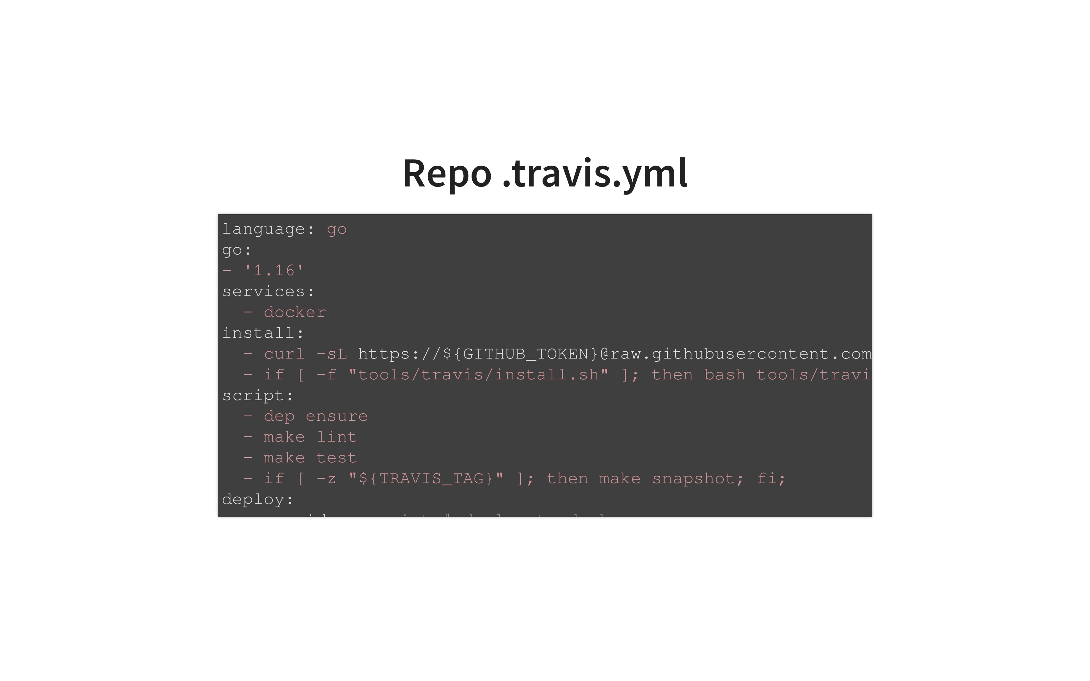

Slide 58
Keep it simple
apiVersion: v1
kind: Service
metadata:
name: api-status
spec:
ports:
- port: 80
protocol: TCP
selector:
name: api-status-nginx
---
apiVersion: apps/v1beta1
kind: Deployment
metadata:
name: api-status-nginx
spec:
replicas: 1
template:
metadata:
labels:
name: api-status-nginx
app: nginx
spec:
containers:
- name: nginx
image: nginx
ports:
- containerPort: 80
Plain kubernetes files
Next step: kustomize
Do not use Helm
We avoid operators

Slide 59


Our stack
On Prem

Slide 60





Observability

Slide 61
Ingress
Simple to configure
Integrations out-of-the-box, e.g., let’s encrypt

Slide 62

Keeping an eye on
Workflows

Slide 63

Summary
Early wins
Train your team members
Keep it simple
Deliver and patch, patch!
https://www.flickr.com/photos/bruno_brujah/

Slide 64
Thank you. Questions?
https://www.flickr.com/photos/bruno_brujah/

Slide 65
Backup slides

Slide 66
Inspirations
Heroku Values (https://gist.github.com/adamwiggins/5687294)
12factorapps (https://12factor.net/)
The Practice of Cloud System Administrator (amazon)
DevOps Handbook (amazon)
Notes:
Makefile has all what we need for the development process

Slide 67
One more thing
Strong opinions weekly hold
Zakładaj najlepsze intencje
Nie zakładaj, że ktoś sobie nie poradzi

Slide 68
One more thing
Murdering the unchosen alternative

Slide 69
OODA
https://upload.wikimedia.org/wikipedia/commons/3/3a/OODA.Boyd.svg

Slide 70
Cooper color code
White
Yellow
Red
https://en.wikipedia.org/wiki/Jeff_Cooper

Slide 71
Zmiana
Twoja praca jest 150% gotowa
Ship it!
Powoli rozszerzaj wsparcie, np., pomagaj
Relacje
Wybierz proces przynoszący największą wartość w firmie
https://gist.github.com/adamwiggins/5687294
Notes:
Makefile has all what we need for the development process

Slide 72
Zmiana
Wszyscy mają pomysły, więc Make it real*
Ship it
Szukaj Early wins
Wsparcie szefa często skraca albo wydłuża drogę.
https://gist.github.com/adamwiggins/5687294
Notes:
Makefile has all what we need for the development process

Slide 73
One more thing
Nie narzekaj, że X nie działa
Przyjdź z pomysłem rozwiązania. Make it Real*.
Let’s together ship it!

Slide 74
Application
Architecture
Dev in team, who is interested in k8S or CloudNative
Dev w teamie, który bawi się UI,…
Team z różnych ról
Notes:
Makefile has all what we need for the development process

